Slide 1
NEW YORK New York
Project 2 – GROUP 3

Slide 2
Contributors
Josh, Adam, FX, Makintha

Slide 3
Point of Interests
Most people know New York for New York City, we want to know more about its Parks in the State
Which State Parks in New York State is the most popular?
Which County is the Popular Park Located?
Attendance of Park Vs. County’s Population and Median Income
Does a State Park stay at No.1 in terms of Attendance?

Slide 4
Data Sources
Here’s where we got the Data…
State Park Site: http://nysparks.com/parks/142/details.aspx
New York State Map: https://www.google.com/maps/search/new+york+state/@42.5326765,-75.8025206,8z
2019 New York State Population: https://www.census.gov/search-results.html?q=population+new+york+state&page=1&stateGeo=none&searchtype=web&cssp=SERP&_charset_=UTF-8
State Park Attendance (We picked 2019 to fit with 2019 Population data) https://data.ny.gov/Recreation/State-Park-Annual-Attendance-Figures-by-Facility-B/8f3n-xj78/data https://data.ny.gov/ https://cugir.library.cornell.edu/catalog/cugir-007865
GeoJson Polygons for each county for New York State: http://gis.ny.gov/civil-boundaries/
US County Boundaries: https://public.opendatasoft.com/explore/dataset/us-county-boundaries/export/?disjunctive.statefp&disjunctive.countyfp&disjunctive.name&disjunctive.namelsad&disjunctive.stusab&disjunctive.state_name&sort=stusab
New York State County Boundaries (GeoJSON format): https://public.opendatasoft.com/explore/dataset/us-county-boundaries/export/?disjunctive.statefp&disjunctive.countyfp&disjunctive.name&disjunctive.namelsad&disjunctive.stusab&disjunctive.state_name&refine.stusab=NY

Slide 5
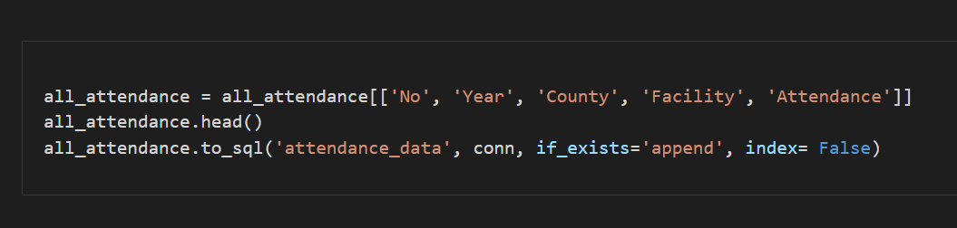
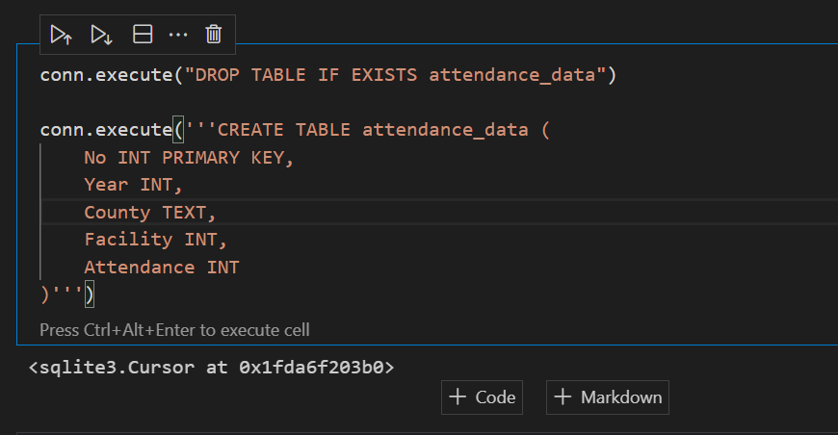
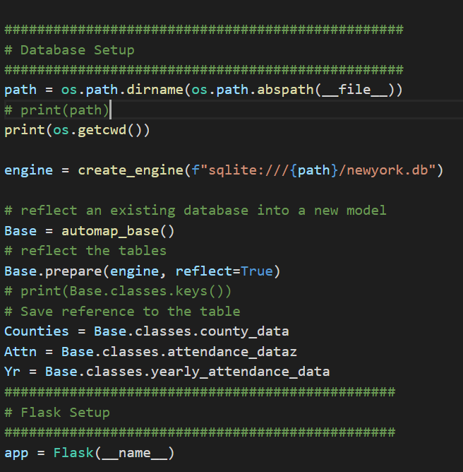
Data Preparation
Data Extraction
Here’s what we did with our Data…
Data Cleaning/
Filtering
Upload to SQLite
Create Flask & Endpoint for API

Slide 6
LINK TO SITE

Slide 7
Findings
After visualizing our Data, here are our findings…
The most popular State Parks in New York State is Niagara Reservation 2015 - 2019
It is in Niagara County
No strong relationship between State Park attendance, County Population and Median Income
Jones Beach overtook Niagara Reservation by 2,339,804 in 2020

Slide 8
Further Exploration
Identify State Parks that overlays to another county
Population in a County vs number of Parks in the County
Activities offered relates to the park’s attendance

Slide 9
Future Application
To create a site for visitor to get information on all the parks and what facilities they offer
To understand the peak times of a state park
To improve the state park (facilities and services) depending on the attendance numbers
Predictive maintenance and budgeting
Here’s what our finding can be used in the future…

Slide 10
THANK YOU!
Any Questions?

